Slide 1
Quick Notes
Elastic Wave Simulation

Slide 2
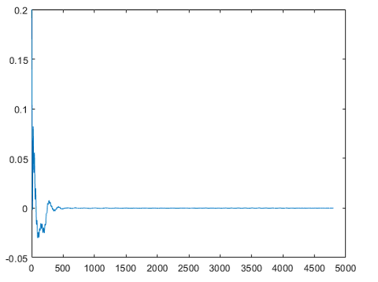
Quadratic gel simulation (no air), PML, no bc velocity or stress, uz = 1 for timestep 1, then 0, no dirichlet
Note: if there is no Dirichlet, vel = 0 at bottom doesn’t work …

Slide 3
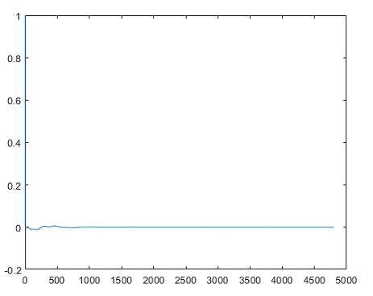
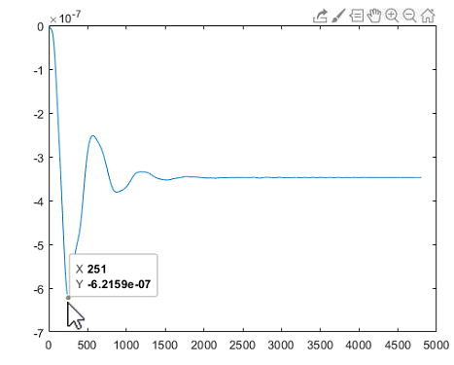
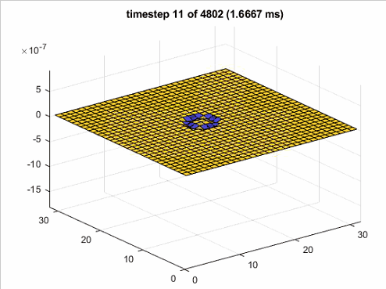
Quadratic gel simulation (no air), PML, no bc velocity or stress, uz = 1 for timestep 1, then 0, dirichlet

Slide 4
Round gel simulation with air, PML, no bc velocity or stress, uz = 1 for timestep 1, then 0, dirichlet
Velocity and position = 0 after timestep 1

Slide 5
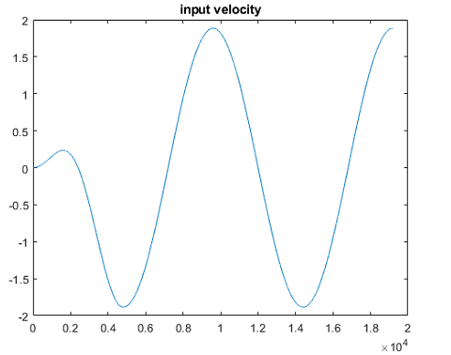
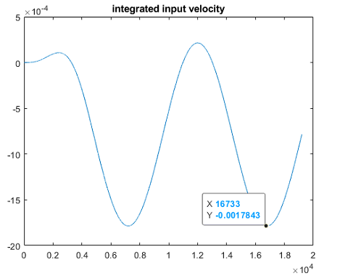
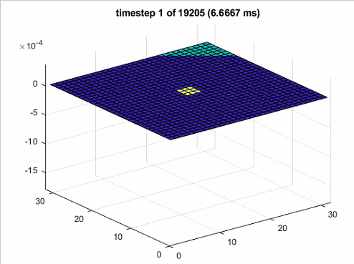
Round gel simulation with air, PML, no bc velocity or stress, uz = sinusoidal, dirichlet

Slide 6
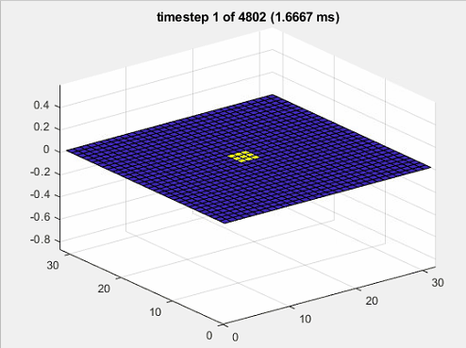
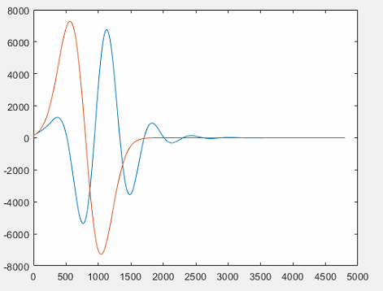
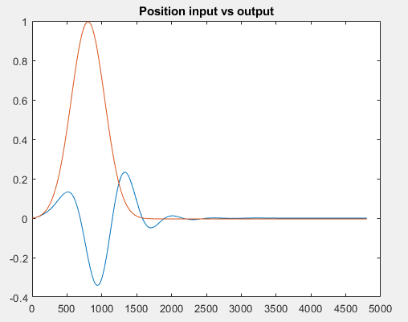
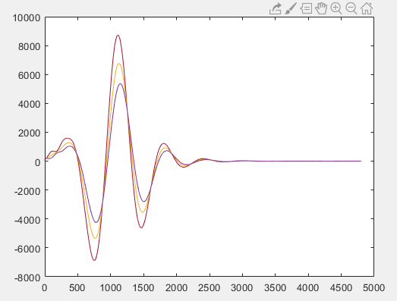
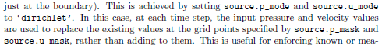
Quadratic gel simulation (no air), PML, no bc velocity or stress, uz = gaussian Dirichlet
Dirichlet -> velocity different then defined?
Different velocities even though they are defined to be the same (source of 9 nodes)

Slide 7
Quadratic gel simulation (no air), PML, no bc velocity, stress = 0 on the outside, uz = gaussian, dirichlet
Exploding (a bit later without a PML(?))

Slide 8
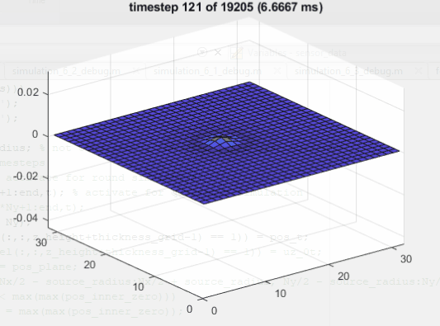
Quadratic gel simulation (no air), PML with alpha = 0 (reflecting on opposite site), no bc velocity or stress, uz = gaussian Dirichlet
Using no PML means reflecting on opposite site -> for symmetric model same as reflecting bc (?) -> oscillation doesn’t seem to decay

Slide 9
Quadratic gel simulation (no air), PML with alpha = 0 (reflecting on opposite site), no bc stress, uz = gaussian Dirichlet, velocity bc at bottom
Explodes, velocities are not 0, even though defined (Dirichlet doesn’t work?)
Difference to simulation before (that worked): BC at the bottom (velocity = 0), simulation not stable even though CFL = 0.1
Thickness in z-direction is 14mm and displacement 1mm, grid spacing 5mm -> try 1mm instead: same problem, velocity doesn’t stay 0 (also not in the beginning when the numbers are still very low)
Only last layer vel = 0 becomes later unstable than 2 layers
Trying to set absorption higher for reflecting bcs

Slide 10
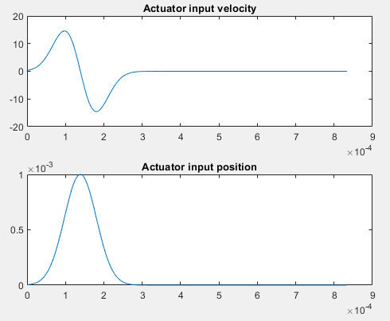
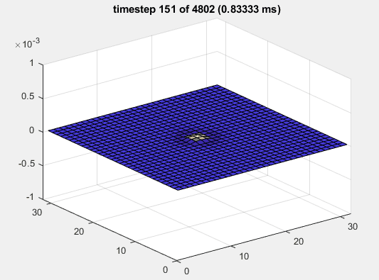

Absorption coefficient
Both alpha = 0.5 (first one)
Alpha sheer = 5000 (second one)
Dt = 1.7e-7
Alpha sheer = 50.000 instable for that dt and dt = 3.4e-8
For higher shear alpha coefficient, simulation is unstable from >50000, before its not big enough

Slide 11
Debug of Simulation 7
For t_end = 0.001 and dt = 0.005 * spacing / c_compression
max_z =
0.2321
min_z =
-0.3150
For t_end = 0.001 and dt = 0.1 * …
max_z =
1.0435e+288
min_z =
-1.2631e+288

